Slide 1
A MACHINE LEARNING APPLICATION FOR PREDICTION LOAN DEFAULT BASED ON CONSUMER BEHAVIOR
TEAM MEMBERS PROJECT COORDINATOR
VISHVA A 210701314 Karthick V,
VINOTH RAJ G 210701509 Associate Professor,
Department of Computer Science and Engineering

Slide 2
Agenda
Abstract
Introduction
Literature Review
Research Gaps
Proposed Methodology
Results and Discussion
Comparative Analysis
Conclusion and Future Work
References

Slide 3
Abstract
This project presents a Loan Prediction System utilizing machine learning to evaluate and predict loan eligibility for applicants. By leveraging historical loan data, the system employs algorithms like Logistic Regression, Decision Trees, and Random Forests to analyze applicant information such as income, credit history, and employment details. The model is trained and validated to ensure high accuracy and reliability. This automated approach streamlines the loan approval process, reduces human error, and enhances decision-making efficiency for financial institutions, providing a robust tool for assessing credit risk and managing loan portfolios effectively.
Keywords: Machine Learning, Loan Approval Prediction, Algorithms, Random Forest, Logistic Regression, K Nearest Neighbor,

Slide 4
Introduction
A Loan Prediction System using Machine Learning leverages advanced algorithms to predict the likelihood of loan approval for applicants. By analyzing historical data and key applicant features such as credit score, income, and employment history, the system enhances decision-making processes for financial institutions. This approach not only increases accuracy and efficiency but also reduces human bias and processing time. Implementing such a system can lead to improved customer satisfaction and better risk management, ultimately contributing to more robust financial operations and profitability for lenders.

Slide 5
Literature Review
Paper Title | Advantages | Disadvantages | Outcomes
Loan Approval Prediction Using Machine Learning Algorithms | High accuracy, reduces human error, quick processing | Requires high-quality data, complex algorithms | Improved loan approval accuracy and reduced processing time
Predictive Analytics for Loan Default Prediction | Early identification of potential defaulters, improved risk management | Possible overfitting, dependency on historical data | Enhanced ability to mitigate risks associated with loan defaults
A Comparative Study of Machine Learning Techniques for Loan Default Prediction | Comparison of multiple algorithms, identification of the most effective models | Requires extensive computational resources, data preprocessing | Identification of the most accurate and efficient algorithm for loan default prediction

Slide 6
Literature Review
Paper Title | Advantages | Disadvantages | Outcomes
Machine Learning Techniques for Credit Risk Evaluation | Improved credit risk assessment, better decision-making for lenders | Data privacy concerns, need for continuous model updates | More reliable credit risk evaluations and better informed lending decisions
Loan Eligibility Prediction System Using Ensemble Learning Techniques | High prediction accuracy, robustness due to ensemble methods | Computationally intensive, may require complex implementation | Increased accuracy and reliability in predicting loan eligibility
Application of Deep Learning in Loan Default Prediction | Ability to capture complex patterns in data, high predictive performance | Requires large datasets, longer training times | Enhanced predictive performance in identifying loan defaults
Predicting Loan Approval using Decision Trees | Easy to interpret, fast and efficient | Prone to overfitting, less effective with noisy data | Quick and interpretable loan approval predictions

Slide 7
Literature Review
Paper Title | Advantages | Disadvantages | Outcomes
Using Random Forest Algorithm for Loan Approval Prediction | High accuracy, handles large datasets well, robustness to overfitting | Interpretability issues, need for parameter tuning | Improved loan approval prediction accuracy with robustness against overfitting
Credit Scoring and Loan Default Prediction Using SVM | High accuracy in classification, effective with small to medium-sized datasets | Sensitive to parameter settings, can be computationally expensive | Effective credit scoring and loan default prediction with high classification accuracy
Neural Network Approaches for Predicting Loan Defaults | Ability to model complex relationships, high accuracy | Requires large datasets, black-box nature leading to lack of interpretability | High accuracy in predicting loan defaults, capturing complex non-linear relationships in data

Slide 8
Research Gaps
Data Quality and Availability: Many studies rely on high-quality, extensive datasets, which are often not available in real-world scenarios, leading to a gap in the applicability of these models.
Model Interpretability: Advanced machine learning models, such as neural networks and ensemble methods, often lack interpretability, making it difficult for financial institutions to understand and trust the predictions.
Handling Imbalanced Data: Loan datasets are often imbalanced, with fewer defaults than approvals. Many existing models struggle to effectively handle this imbalance, leading to biased predictions.
Generalization Across Regions: Models trained on data from specific regions or financial institutions may not generalize well to other regions with different economic conditions and borrower behaviors.
Dynamic Economic Factors: Existing models often do not account for dynamic economic factors and market conditions, which can significantly impact loan repayment behaviors.
Ethical and Bias Concerns: There is a need for more research into ensuring that machine learning models do not perpetuate existing biases in lending practices, which can lead to unfair treatment of certain demographic groups.

Slide 9
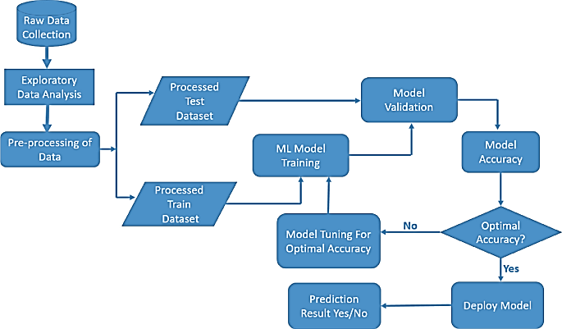
Proposed Methodology

Slide 10
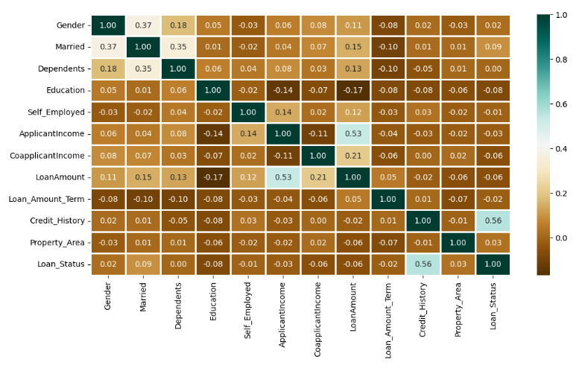
Results And Discussion
The above heatmap is showing the correlation between Loan Amount and ApplicantIncome. It also shows that Credit_History has a high impact on Loan_Status.

Slide 11
Comparative Analysis
Algorithm | Training Accuracy | Testing Accuracy
RandomForestClassifier | 98 | 82.5
KNeighborsClassifier | 78 | 63.7
SVC | 68 | 69.16
LogisticsRegression | 79 | 80.0
The table below provides the accuracy score for training and testing prediction.

Slide 12
Conclusion
The implementation of the system to analyze the allocation of loan to the individual based on their details of the past and current details with the help of machine learning algorithm provides insights to the banking institutes to set the basic criteria for allocation of loan to them. The accuracy of the algorithm is useful for setting the criteria for each of the predictions for individuals. The RandomForestClassifier algorithm provides the overall highest accuracy with the dataset compared to the other algorithms implemented. Each algorithm has its own merits and demerits. The algorithm with highest accuracy is used.

Slide 13
Future Work
The system can be improvised with the implementation of the updated algorithms with the help of real time data updating and training the model in a periodic way can improvise the accuracy. Providing a dataset which consists of present criteria for the loan prediction will improvise the algorithm’s accuracy and the implementation of the system will be made efficient.

Slide 14
References
[1] Vaidya and Ashlesha, Predictive and probabilistic approach using logistic regression: Application to prediction of loan approval, 2021 13th International Conference on Computing, Communication and Networking Technologies (ICCCNT). IEEE, 2021.
[2] Amin, Rafik Khairul and Yuliant Sibaroni, Implementation of decision tree using C4. 5 algorithm in decision making of loan application by debtor (Case study: Bank pasargad of Yogyakarta Special Region), 2022 8rd International Conference on Information and Communication Technology (ICoICT). IEEE, 2022.
[3] Arora, Nisha and Pankaj Deep Kaur, A Bolasso based consistent feature selection enabled random forest classification algorithm: An application to credit risk assessment, Applied Soft Computing 86 (2020), 105936.
[4] Yang, Baoan, et al, An early warning system for loan risk assessment using artificial neural networks, Knowledge-Based Systems 14.5-6 (2024), 303-306.
[5] Metawa, Noura, M. Kabir Hassan and Mohamed Elhoseny, Genetic algorithm based model for optimizing bank lending decisions, Expert Systems with Applications 80 (2022), 75-82.

Slide 15
References
[6] Hassan, Amira Kamil Ibrahim and Ajith Abraham. "Modeling consumer loan default prediction using ensemble neural networks, 2020 International Conference On Computing, Electrical And Electronic Engineering (ICCEEE). IEEE, 2020.
[7] X.Frencis Jensy, V.P.Sumathi, Janani Shiva Shri, “An exploratory Data Analysis for Loan Prediction based on nature of clients”, International Journal of Recent Technology and Engineering (IJRTE),Volume-7 Issue-4S, November 2018.
[8] Pidikiti Supriya, Myneedi Pavani, Nagarapu Saisushma,Namburi Vimala Kumari, k Vikash,“Loan Prediction by using Machine Learning Models”, International Journal of Engineering and Techniques.Volume 5 Issue 2, Mar-Apr 2023
[9] Kumar Arun, Garg Ishan, Kaur Sanmeet, ―Loan Approval Prediction based on Machine Learning Approach‖, IOSR Journal of Computer Engineering (IOSR-JCE), Vol. 18, Issue 3, pp. 79-81, Ver. I (May-June. 2021).

Slide 16
References
[10] Aboobyda Jafar Hamid and Tarig Mohammed Ahmed, ―Developing Prediction Model of Loan Risk in Banks using Data Mining‖, Machine Learning and Applications: An International Journal (MLAIJ), Vol.3, No.1, pp. 1-9, March 2023.
[11] S. Vimala, K.C. Sharmili, ―Prediction of Loan Risk using NB and Support Vector Machine‖, International Conference on Advancements in Computing Technologies (ICACT 2022), vol. 4, no. 2, pp. 110-113, 2022.
[12] Pidikiti Supriya, Myneedi Pavani, Nagarapu Saisushma, Namburi Vimala Kumari, kVikash,“Loan Prediction by using Machine Learning Models”, International Journal of Engineering and Techniques.Volume 5 Issue 2, Mar-Apr 2023
[13] Nikhil Madane, Siddharth Nanda,”Loan Prediction using Decision tree”, Journal of the Gujarat Research History, Volume 21 Issue 14s, December 2022.

Slide 17
Thank you

